Slide 1
Master Research
Kees Wesselink
31-10-2016

Slide 2
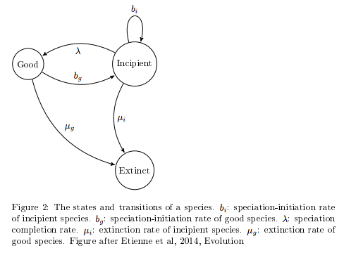
Protracted Birth Death (PBD) Model
Resolves exponentially increasing number of species
Good and incipient species
Two birth rates
Two extinction rates
Speciation completion rate
R.S. Etienne, and J. Rosindell. (2011) "Prolonging the past counteracts the pull of the present: protracted speciation can explain observed slowdowns in diversification." Systematic Biology: syr091.

Slide 3
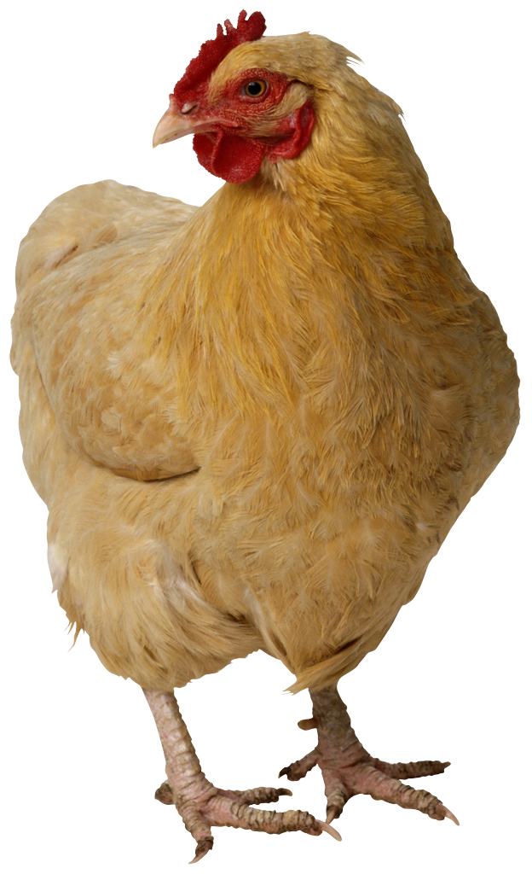

Ecological and Sexual Selection (ESS) model
f m
Ecological
trait
x_{f}
Ecological trait
x_{m}
3 traits:
Ecological trait
Female preference trait
Male trait
Female chooses male
(or not to mate)
Female pref
p_{f}
Female pref
p_{m}
Male trait
q_{f}
Male trait
q_{m}
G. Sander van Doorn & Franz J. Weissing. (2001) ”Ecological versus Sexual Selection models of Sympatric speciation: a Synthesis." Selection 2, p. 17-40.

Slide 4
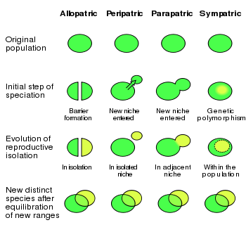
Should an individual based mechanism be implemented in the protracted birth death model?
What is the probability of sympatric speciation in nature?
What are the differences between the two models?
How can we refine either model?
Allopatric Sympatric

Slide 5
Why?
A better understanding of speciation
Focus on unique scenarios
Most simplistic model with an ecological and a sexual trait
G. Sander van Doorn & Franz J. Weissing. (2001) ”Ecological versus Sexual Selection models of Sympatric speciation: a Synthesis." Selection 2, p. 17-40.
Sergey Gavrilets. (2003) “Perspective: Models of Speciation: What have we learned in 40 years?” Evolution, 57(10), p.2179-2215

Slide 6
What is (not) known
Sympatric speciation is possible
Few details known
Pull of the present slowed by PBD
G. Sander van Doorn & Franz J. Weissing. (2001) ”Ecological versus Sexual Selection models of Sympatric speciation: a Synthesis." Selection 2, p. 17-40.
Sergey Gavrilets. (2003) “Perspective: Models of Speciation: What have we learned in 40 years?” Evolution, 57(10), p.2179-2215
R.S. Etienne, and J. Rosindell. (2011) "Prolonging the past counteracts the pull of the present: protracted speciation can explain observed slowdowns in diversification." Systematic Biology: syr091.

Slide 7
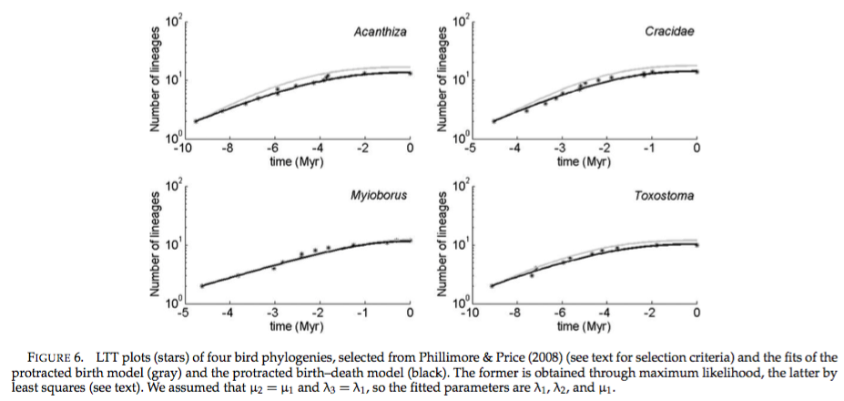
Biological context
Number of new species increases slower through time
Time
Niches are being filled
Speciation takes time
R.S. Etienne, and J. Rosindell. (2011) "Prolonging the past counteracts the pull of the present: protracted speciation can explain observed slowdowns in diversification." Systematic Biology: syr091.

Slide 8
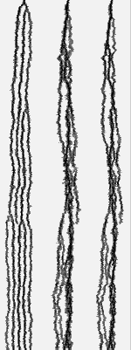
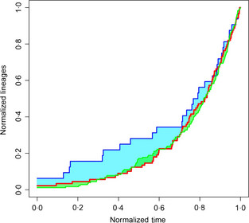
Method
Find parameters for ESS model
Find number of species to cut off simulations
Run ESS model to find parameters for PBD model
Analyse outcomes with nLTT
T. Janzen, S. Höhna, R.S. Etienne. (2015) “Approximate Bayesian Computation of diversification rates from molecular phylogenies: introducing a new efficient summary statistic, the nLTT “. Methods in Ecology and Evolution, 6 p.566-575

Slide 9
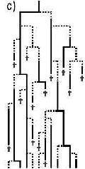
Hypothesis
PBD can also be sympatric
Needs individuals
R.S. Etienne, and J. Rosindell. (2011) "Prolonging the past counteracts the pull of the present: protracted speciation can explain observed slowdowns in diversification." Systematic Biology: syr091.

Slide 10
Discussion
Only using LTT
Don’t get too caught up in the details
Not certain how many species the ESS can handle

